Slide 1
Church Body Life
Warren Henderson

Slide 2
Church Body Life
The Church is the living body of Christ; Christ is the Head of the Church (Eph. 1:22-23).
For a body to function properly it must follow a prescribed order – each cell in our bodies is DNA encoded with the entire pattern to follow.
  Similarly, a divinely imposed pattern of Church body life is contained in Scripture for all believers to follow.
  If this pattern is ignored the Church will be prone to abnormal growth, sickness, or lethargic body life.

Slide 3
What is the Pattern of the Church?
Session # 1

Slide 4
The Church is an Object Lesson
“That I should preach among the Gentiles the unsearchable riches of Christ, and to make all see what is the fellowship of the mystery, which from the beginning of the ages has been hidden in God who created all things through Jesus Christ; to the intent that now the manifold wisdom of God might be made known by the church to the principalities and powers in the heavenly places, according to the eternal purpose which He accomplished in Christ Jesus our Lord” (Eph. 3:8-11).

Slide 5
What is God’s Pattern For the Church
1. CHRIST IS THE HEAD AND CENTER OF THE CHURCH (Eph. 1:22-23; Col. 1:18)
Expression: Through weekly breaking of bread in remembrance of Christ (Luke 22:19, Acts 2:42, 20:7).
Distortion: Earthly head (clergy – one pastor) and earthly headquarters (divisions and denominations).
2. UNITY OF ALL BELIEVERS (1 Cor. 12:13; Eph. 4:3-4; John 17:21-23, Heb. 10:25)
Expression: Identifying with Biblical names: Christians, believers, saints, brethren, etc.
Distortion: Denominational names, local church membership, and isolationism.

Slide 6
What is God’s Pattern For the Church
3. PRIESTHOOD OF ALL BELIEVERS (Rev. 1:6, Heb. 10:22, 1 Pet. 2:5, 10)
Expression: Spirit-led worship, all believers equipped with gifts to serve & edify (Eph. 4:16).
Distortion: Clergy led services, ministry by “professionals,” church traditions leading to rote.
4. FAMILY LIFE OF THE LOCAL CHURCH (Eph. 2:19 – the household of God)
Expression: Family activities per Acts 2:42, Letters of Introduction, Reception into Fellowship.
Distortion: A mixed multitude of saved and lost, busy work with no spiritual value, committees.

Slide 7
What is God’s Pattern For the Church
5. SANCTITY OF THE SEXES (Gen. 1:27, 2:24, 1 Tim. 2:11-14)
Expression: Proper roles in church (men leading, women supporting), symbolic truth: head
covering.
Distortion: Headship/Sonship confusion, cultural arguments to erode away God’s order.
6. PLURALITY OF LEADERSHIP: SAFETY IN MULTITUDE OF COUNSELORS (Tit. 1:5, Acts14:23)
Expression: Apostles, proactive elders – spiritual men, Deacons: administration in temporal things (1 Tim. 3:12).
Distortion: One man ministry – promotes church spectators, pride, & no accountability.

Slide 8
What is God’s Pattern For the Church
7. ONE MISSION: THE GREAT COMMISSION (Matt. 28:18-20 – reaching the lost for Christ)
Expression: Believers are witnesses in the world & the church is sending out workers to do the same. Must proclaim an accurate message.
Distortion: Come to church for social activities or you must come to church before we will witness to you — “you come” vs. “we go.”

Slide 9
Summary of Sevenfold Pattern
This sevenfold pattern reflects significant truths that God wants to display in the Church; these convey the glory of God:
1. Christ is to be the center of our attention; the Father is honored when His Son is honored.
2. Just as God is one, all believers are one in Him.
3. God alone is to be worshipped and all believers are able priests to do so.
4. God is the source of all good things; those who truly compose the family of God will bask in His goodness forever.
5. In heaven, God’s glory, and its reflection in others, will be all that is seen.
6. God is masculine, plural in persons, and perfectly unified in all that He does.
7. God is merciful, gracious, long-suffering, and desires heaven to be full of redeemed people from every nation, tribe, tongue, and kindred.

Slide 10
What is the Purpose of the Church?
Session # 2

Slide 11
What is the Purpose of the Church?
The Upward Ministry – Offer Up!
  The exaltation of God in worship (the priest).
The Inward Ministry – To Build Up!
The edification of all believers (the shepherd).
The Outward Ministry – To Reach Out!
    The evangelization of all nations:
    The fisherman – going were the fish are, landing one at a time.
    The farmer – going into the field to sow gospel seed.
A healthy assembly will be active in all three ministries – believers will neglect none!

Slide 12
The Upward Ministry
The local Church gathers in the name of and to Christ; not to a particular doctrine, governmental form, method, political agenda, individual, or schooling movement.
  Christ is the head; the Church is to uphold the head (Eph. 1:22-23).
  Corporately weekly remembrance – the Lord’s Supper (Acts 2:42, 20:7).
2. All believers are priests (1 Pet. 2:5-9) and are able to worship God.
  Individual worship can be a 24/7 experience (Rom. 12:1-2).
  Corporate worship (Acts 20:7; 1 Cor. 11:18)

Slide 13
The Inward Ministry
Conditions for Assembly Growth
(1) Unity (must affirm Christ as Lord; 1 Cor. 1:1-10)
Church unity reveals God’s glory (John 17:21-23).
Acts: one accord = church grew vs. disunity = No power.
Goal: to lay hold of the mind of Christ, then same mindedness will be achieved (Phil. 2:1-5).

Slide 14
The Inward Ministry
Conditions for Assembly Growth (cont.)
(2) Mentoring (not training programs)
A local assembly will breath in and out over the course of its life, but there must be body life.
An assembly that is in steady decline should first critique its inward ministry.
  Our first tendency is to think outward (evangelism).
  There are reasons for decline: wrong attitudes, religious pride, lack of unity, traditions, not yielding to truth and lack of mentoring relationships.
  A sick body is not prone to reproduce!

Slide 15
What is Biblical Training?
Eph 6:4: “Fathers, do not provoke your children to wrath, but bring them up in the training and admonition of the Lord.”
2 Tim 3:16: “All scripture is given by inspiration of God, and is profitable for doctrine, for reproof, for correction, for instruction in righteousness.”
  NASV renders the ends of this verse “for training in righteousness.” The NIV translate it “be thoroughly equipped.”
  Paideia means: “education or training; disciplinary correction.”
  Translated four times in Hebrews 12 as “chastening.”
Titus 2:12: “Teaching us that, denying ungodliness and worldly lusts…”
2 Tim 2:25 “In meekness instructing those …”
  Paideuo means to train up, to educate, to instruct, to teach.
Summary: Biblical training includes: instruction in righteousness, disciplinary correction, teaching doctrine, and equipping for godly living (e.g. Prov. 22:6 concept).

Slide 16
Mentoring vs. Training Programs
Training generally means to teach someone how to do something so that they become qualified to do it (e.g. doctor, engineer, nurse, etc.).
  Yet, the means of edifying the body of Christ comes from supernatural gifts from God (Eph. 4, 1 Cor. 12).
  Thus, no training programs in the NT to make evangelists, teachers, or pastors.
  We do see encouragement, exhortations, mentoring, and examples to follow but that is not the same as a training program.

Slide 17
1. Equipping in Righteousness
Beneficial Church body-life is enjoyed as each member learns and practices sound doctrine while learning how to properly use his or her spiritual gifts:
  “All Scripture is given by inspiration of God and is profitable for doctrine, for reproof, for correction, for instruction in righteousness … that the man of God may be complete, thoroughly equipped for every good work” (2 Tim. 3:16-17).
  Godly character must be evident to be a good work!

Slide 18
2. Equipping for Ministry
The Lord Jesus gave gifted individuals to the Church for a particular reason: “for the equipping (katartismos) of the saints for the work of ministry, for the edifying of the body of Christ” (Eph. 4:12).
  Katartismos means “to completely furnish”
Every believer in the body of Christ has a work of ministry to engage in, the benefit of which will bless the entire body (equipping and experience are integral).
As believers rightly use their spiritual gifts they equip others in the body to do ministry, which then passes the original blessing along to further edify the body.
  Children’s wading pool illustration.
  Does your ministry equip others to fulfill theirs?
Involvement builds commitment within the local church.

Slide 19
The Goal of Mentoring
1. To be thoroughly trained in righteousness unto every good work, a believer will rely on:
  God’s Word,
  The guidance of the Holy Spirit
  The mentoring of spiritually-minded believers.
2. To be equipped for ministry. Believers will accomplish their ministry as they continue to grow, exercise and develop their spiritual gifts.
The world is not to be the believer’s playground, its God’s classroom.
  Believers are called to maturity and to service – the two cannot be separated.

Slide 20
Biblical Principles for the Mentor and Mentee
Session # 3

Slide 21
The Outward Ministry
Session # 4

Slide 22
The Outward Ministry
In nature, healthy bodies naturally reproduce!
In the spiritual realm, healthy assemblies will be engaged in reproduction.
  Reproduction is a normal part of body life!

Slide 23
The Outward Ministry
The Church is responsible for sharing the gospel.
Great Commission was spoken to the disciples on three different occasions: Jerusalem - resurrection day (Mark, Luke and John), on a mountain in Galilee (Matthew), Mt. of Olives – ascension (Acts).
  The disciples were responsible to evangelize.
  Eleven disciples could not teach all nations all that Christ taught, but subsequent disciples could.
  The Lord confirms the completion of His command (end of the Church age).
The “Great Commission” is a propagating command to every Christian by Christ Himself to be a witness for Him, to preach the gospel, and then teach new coverts to “be” disciples of Christ until He returns.

Slide 24
The Outward Ministry
Marked by Corporate Prayer: The NT Church spent their time praying for boldness and for those being persecuted for their boldness (Acts 4:29, 12:5; Phil. 1:19).
Believers don’t pray because there is either a dependency and/or a submission issue.
Leonard Ravenhill: “No man under heaven will be greater than his prayer life.”

Slide 25
Going Out Where the Lost Are
Examples:
The Lord sent the twelve to preach throughout Galilee (Luke 9).
The Lord sent the seventy to preach throughout Judea (Luke 10).
Paul preached “publicly” and from “house to house” in Ephesus (Acts 20:20).
Philip preach in Samaria (Acts 8:5).
Door to Door work is one type of Seed Sowing in which the harvest comes later.

Slide 26
Is Door to Door Work Effective?
Jehovah’s Witnesses
Have grown from 360 members in 1893 to 6 million in 2005
In 1999, Jehovah’s Witnesses Worldwide reported that a total of nearly 6 million JW’s spent about 1.1 billion hours evangelizing in 234 countries.
JWs are adding 45 new congregations per week
Mormons
They are sending out approximately 560,000 full-time missionaries and spending about 1.3 billion hours witnessing per year.
Every Wednesday, 500 new Mormon missionaries report for 3 to 9 weeks of intensive training at the Missionary Training Center in Provo, Utah.
Conversion rate to Mormonism is 2,000 to 3,000 people per day.
The Mormons are building nearly two new churches per day.

Slide 27
Is Door to Door Work Effective?
Answer: The Mormons and JW’s think so.
  Without the truth or the Holy Spirit’s assistance these cults are growing at an alarming rate worldwide through sheer determination and effort.

Slide 28
Preparation
What is the objective for the visit?
Establishing connections and looking for more near term opportunities.
  Meet your neighbors (give gift: calendars, seasonal greetings, prints)
  An invite to special family meetings or children’s club
  Announcing backyard children’s party or hay rack ride
One time gospel sweep (Seed sowing for a later harvest)
  Use Seed Sowers or Uplook prints
  Gospel CDs
  Booklets: The Bible: Myth or Divine Truth, Afterlife
  Sowing seed over a variety of soils and variety of situations in time

Slide 29


Slide 30
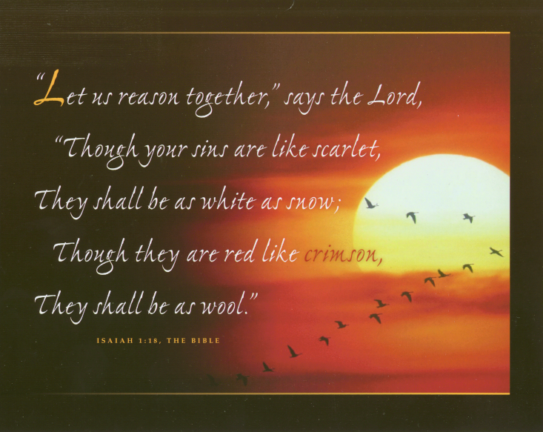

Slide 31
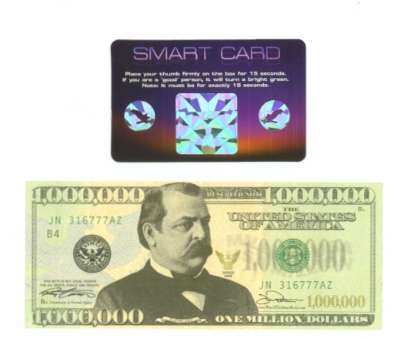

Slide 32
Preparation (cont.)
What materials/gift should be handed out?
Colorful professional done pictures and prints are best.
Need clear plastic bag to display handouts
  Leave between doors if no one answers.
If multiple handouts, pack such that flyers face out both directions with largest in the middle and smallest on outsides – suggest no more than three articles. You should have a response card or contact info stamped on tracts.
What else should you have?
Have a small note pad/pen to write down names/addresses for follow up (complete immediately).
Have a pocket Bible (not too small) & some assorted tracts.
Water, if hot
Don’t forget your zone map (mark off the area as you do it).

Slide 33
Preparation for Group Outreach
Have a outreach coordinator:
Have one person in charge of assigning areas: take into the account area, and individual’s abilities (e.g. don’t send two teenage girls into rough areas).
Have areas marked out clearly so coverage is ensured, but not twice (Use mapquest.com or similar program for mapping).
Coordinator ensures plenty of materials for distribution and transportation is available for workers (2 teams into 1 zone with 1 vehicle works well).

Slide 34
Preparation for Group Outreach
Have a home base:
Someone available to answer phone calls, coordinate food for workers.
Stuff more bags, give new territories, and watch children.
If a whole day effort allow 1.5 hours for lunch, to rest & to share experiences.
Meet 45 minutes to an hour before outreach time for prayer/instruction.
Days and timing:
Saturday mornings, Sunday afternoons are best.
  People tend to be busy Saturday afternoons.
  Weekdays from10:30 & 1:30 (catch 2nd shift people and moms).
Don’t start before 9:30 AM and try to end before 5:30 PM

Slide 35
Maps by Zones

Slide 36
Going Door to Door
Teams:
Be discerning on presentation: two men can be intimidating.
  Pair a man/woman, or two women, adult/child, or two alone.
  If alone, have another worker in eyesight.
Things to do between houses:
Pray and write down information from last house.
Hum or sing a praise song or hymn between houses.
  “The joy of the lord is our strength” (Neh. 8:10).
Be observant: antique car, flowers, country fixtures, toys in yard, plaque on door, care of yard, wood burning, sports stickers, baby car seat in vehicle.
Use sidewalks don’t walk through yards.

Slide 37
Going Door to Door
Ways not to look like a JW or Mormon:
Don’t wear white shirts, but instead dress to fit into the neighborhood.
Work with a teenager or child.
Identify yourself (be personal) and what you are doing.
If possible touch the person you are talking to (shake his or her hand).
Smile – outward joy

Slide 38
Going Door to Door
At the Door (my personal preference if knocking):
One foot holding screen door (if screen door is lock – easier to be rejected).
Left hand with packets with right hand free to shake with or hand packet.
Knock rather than ring the door bell (more friendly).
Adjust height to be eye to eye with the person you are speaking to.

Slide 39
Going Door to Door
Making a “connection”: first 15 seconds is critical.
Take note of something said: be a good listener – listening shows love.
  “Who do you want me to vote for?”
  “What are you selling?”
If they are talking a lot (good) let them go, gain more info and pick your lead in.
  You don’t want to waste time; within 3 to 5 minutes transition the conversation into the spiritual realm.
  Ease up for a moment after initial greeting, then come back to gospel.
Probably only one in about sixty will be rude/reject info.

Slide 40
Practical Things
Be friendly (if you are nervous it will make others nervous).
Don’t wear sunglasses when talking to someone (sets up a barrier).
“No Soliciting” sign = knock; “No Religious Canvassing” = no knock.
Be discerning about entering someone’s home - think blameless
  If member of opposite sex, then ask “Is anyone else home?”
  Decline if not. Visit on the porch or an outwardly exposed room.
If there is a chain tied to the post of the porch and it disappears under the porch – assume that there is “something” attached to it.

Slide 41
Practical Things
Which door to go to?
  The one a neighbor would go to; don’t enter garages, carports are OK.
  Don’t go to back door unless it is the obvious choice.
  Minimize people barriers (screen doors, fences, distance, in car).
Be sensitive to situation:
  If mother with crying baby comes to door – just leave info.
  If dogs are tearing down the door or someone is on phone – leave info.
  If you see toddler toys in yard knock softly during nap time.
  If you stop people from working they may reject – better to leave info.

Slide 42
Presentation – What to say?
Develop your own style, based on experience & objective.
  After about 10 visits you will develop a pattern.
Use a bit of humor to soften the initial conversation.
  Have you ever seen a John 3:16 sign between the goal posts while watching a professional football game – it is not a verse about play football, but…
  Have you ever thought about eternity – it is a long time you know.
Wait for your lead in based on conversation/observation.
  “Lead ins” tie the physical realm into a spiritual truth (e.g. John 4).
  The longer you hold a conversation the better odds for a lead in.
Once you have a good lead in plant a question to obtain a non-yes/no answer which then affords an opportunity to review Scripture.
  Review Luke 10:25-26 and Matthew 19:16-22

Slide 43
Connecting and Probing
Listen & ask questions (you are probing for pain & gaining info).
Possible Questions to Transition into Spiritual Conversation:
1. “Do you have any kind of spiritual believe” (Don’t talk about God, Christ, etc. – yet).
2. “Do you go to church any where?” If so, ask them “How does a ________ get to heaven?”
3. “How are you doing in spiritual things?”
4. “Do you ever think about eternity?” Its a long time you know.
5. “Are you good enough to go to heaven?”
6. “Do you think there is a heaven and hell?” “If you died at this moment where would you go?”
7. “If what you believe is not true, would you want to know about it?” Wait. If “no” end visit & wait.
“Are you a good person?” “Does God consider you a good person?”
9. “Have you had your sins forgiven?”
10. “If there is no God why are you getting angry?”

Slide 44
Using Your Evangelism Bible
Use your Bible (Don’t ask permission – “I will show you in two minutes how you can know for sure you will go to heaven.”
Tips on your “Evangelism Bible”:
Should be a concealed weapon quickly deployed (in back or coat pocket).
Large Bibles can be intimidating and they will see it before you’re ready.
Print large enough to read and clear of markings and highlights (except for key words).
Tips on using your “Evangelism Bible”:
Have individual read Scripture aloud: “Faith comes by hearing and hearing by the word of God.”
Use the Lord’s approach with lawyer in Lk. 10:26: Ask questions, refer the hearer to Scripture.
If bad answer, reread verse again, or go to another verse. Go on when you have right answer.

Slide 45
It Only Takes a Few
It only takes a few Christians infused with the power of God to transform our surroundings for Christ.
  The Lord Jesus began His ministry with 11 men.
John Welsey said “give me 100 preachers who fear nothing but sin and desire nothing but God, and I care not a straw whether they be clergy or laymen, such alone will shake the gates of hell.”
Henry Varley: “The world has yet to see what God can do with and for and through and in a man who is fully and wholly consecrated to Christ.”
  A young D. L. Moody heard this statement and he looked up to heaven and said, “By the grace of God I will be that man!”

Slide 46
What is the Purpose of the Church?
The Upward Ministry – Offer Up!
  The exaltation of God in worship (the priest).
The Inward Ministry – To Build Up!
The edification of all believers (the shepherd).
The Outward Ministry – To Reach Out!
    The evangelization of all nations:
    The fisherman – going were the fish are, landing one at a time.
    The farmer – going into the field to sow gospel seed.
A healthy assembly will be active in all three ministries – believers will neglect none!

